Slide 1
Airline Industry Analysis

Slide 2
Framework
Overall Metrics
Quarterly Trends
YoY Trends
Deep Dive into YoY Trends & identify drivers/causes
Outlier cases such as FedEx, United Airlines

Slide 3
Data Cleaning
Data cleaned using SQL; queries inserted along with other attachments
Cases of NA values, Total Column Values not matching etc

Slide 4
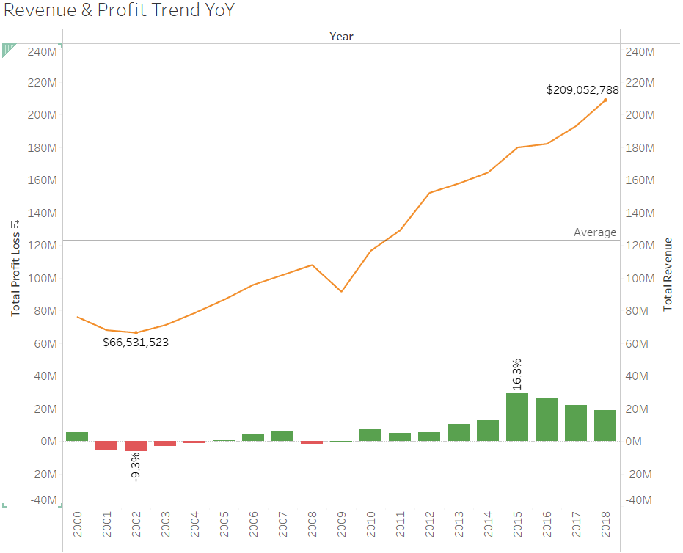

Time-Series(Revenue and Profit) YoY
2001-2009 saw low levels of profitability, with the airline industry being in loss from 2001-2004 as well as in 2008, with the highest loss as a %age of total revenue being 9.3% in 2002.
Revenues increased YoY at an average rate of 6.2% per year
Highest profitability seen in 2015 and 16.3%

Slide 5
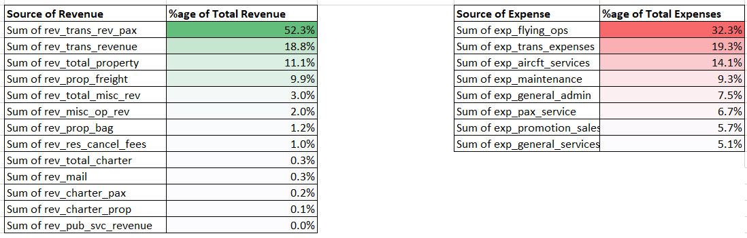
Revenue & Expenses Breakdown
Top 3 contributors to Revenue are Transport_Revenue_Pax, Transport_Revenue And Total Property
Top 3 contributors to Expenses are Flying_Ops, Transport_Expenses and Aircraft Services

Slide 6
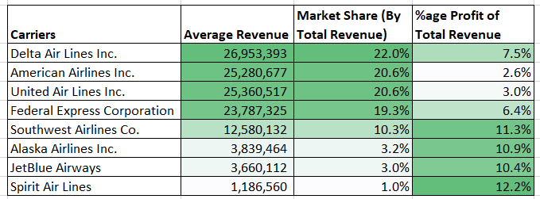
Overall Metrics

Slide 7
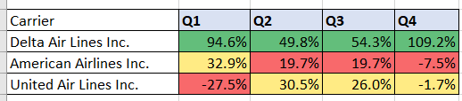
Quarterly Performance – Top 3 Airlines by Revenue
As a %age of Overall Profit for the particular Quarter, we see that Delta remains consistently profitable
American and United Airlines are in loss in Q4
United Airlines is severely in loss in Q1

Slide 8
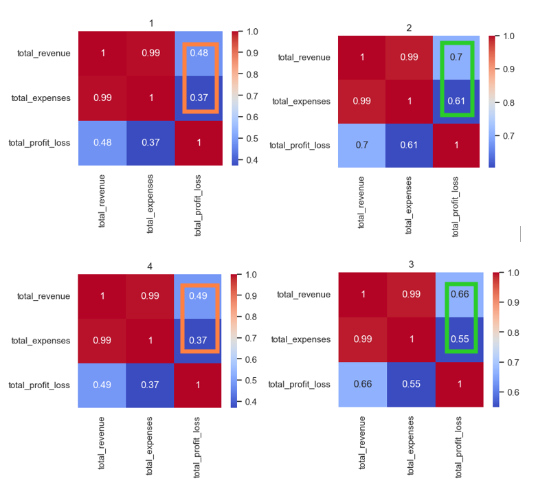
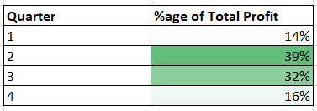
Quarter Trends in Profitability
Quarters 1 & 4 have lower correlation of Total Revenue & Total Expenses with Profit/Loss than Quarters 2 & 3

Slide 9
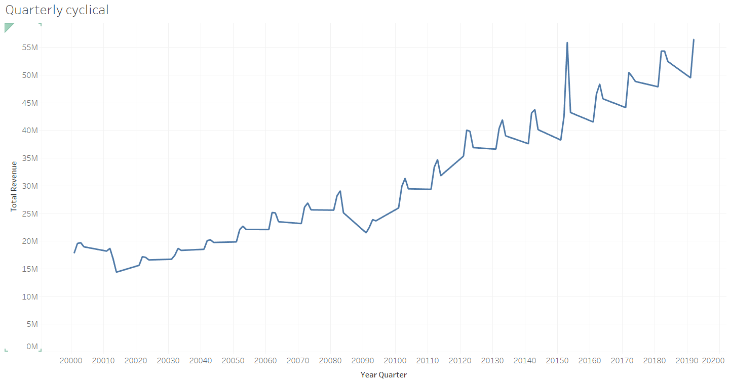
Quarterly Trend in Revenue
Cyclical Trend seen in Quarterly Total Revenue, indicating each quarter bringing with it a unique set of similarities that hold true for same quarters over the years.
For example, Quarter 2 & 3 are in the Summer time and increased costumer demand could be foreseen

Slide 10
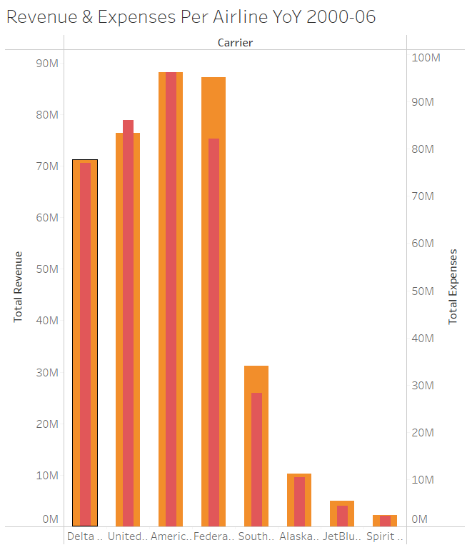
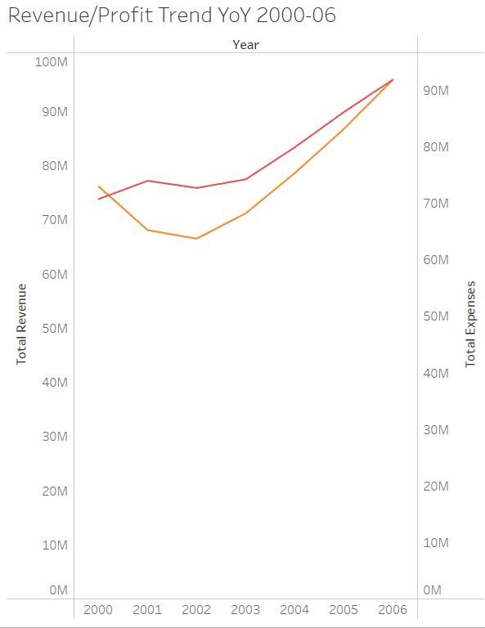

Deep-Dive 2001-2005 Industry Loss
The drivers behind Total Revenue being less than Total Expenses in the years 2001-2005 were 3 airlines; Delta, United & American Airlines

Slide 11
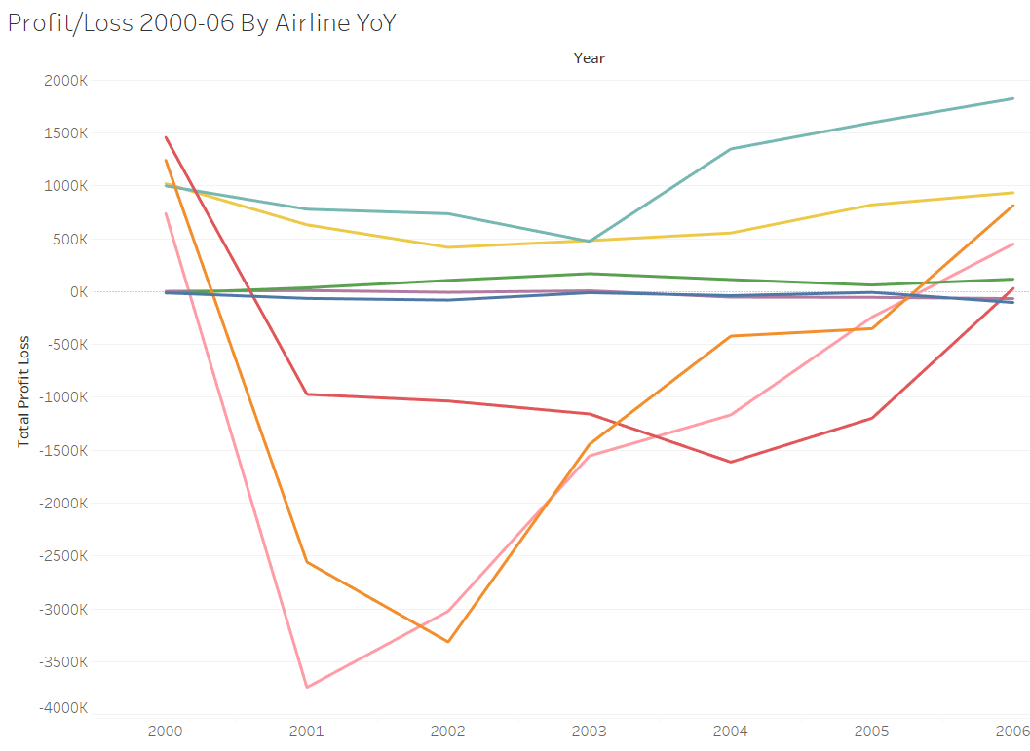
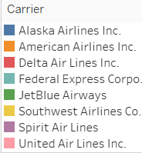
2001-2005 Loss-Making Companies
As can be seen, Delta, United & American Airlines were in loss in these years

Slide 12
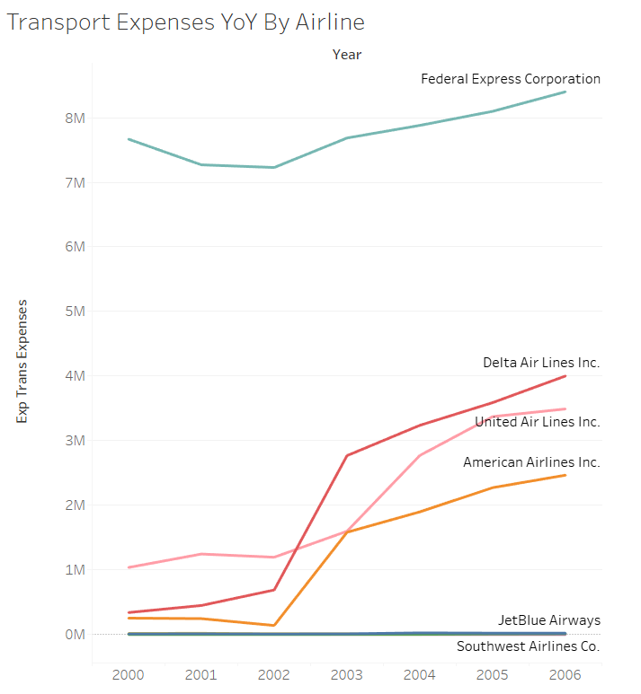
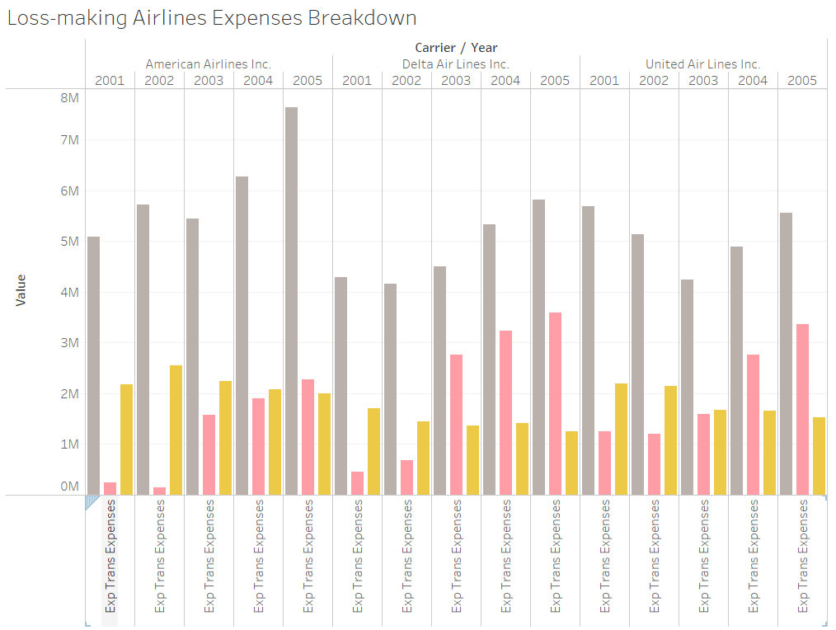

Deep-Dive into the loss-making airlines
An increasing Transport Expense YoY was one of the drivers being increased Total Expenses for the loss-making airlines. The airlines should keep an eye out on optimizing this expense to increase profitability
2001 was 9/11; security concerns

Slide 13
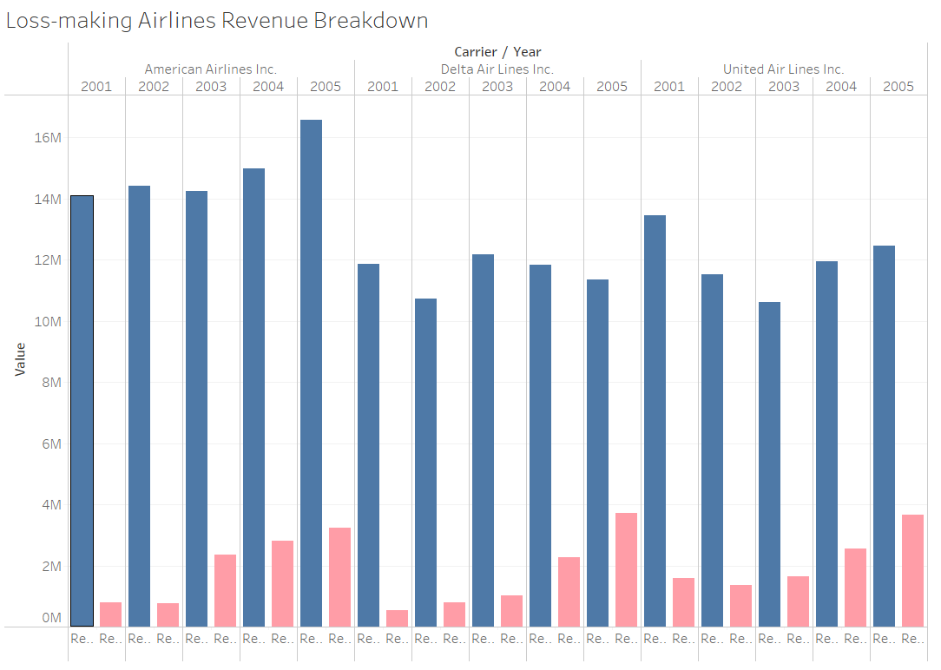

Revenue Breakdown loss-making Airlines 2001-2005
Transport Revenue Pax dropped for Delta and United Airlines leading to lower Total Revenues in those years

Slide 14
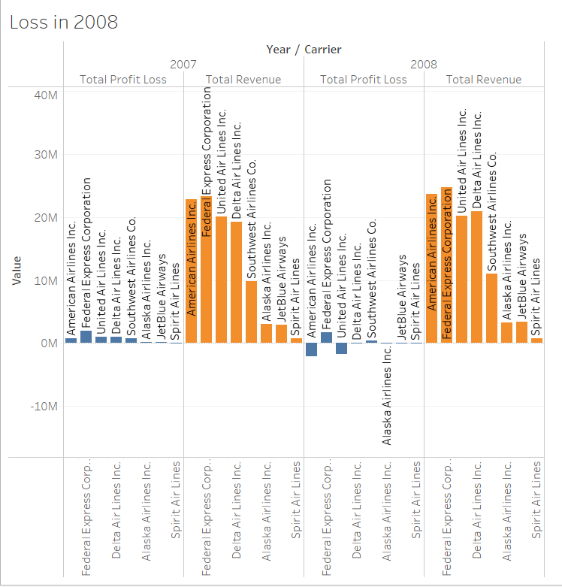
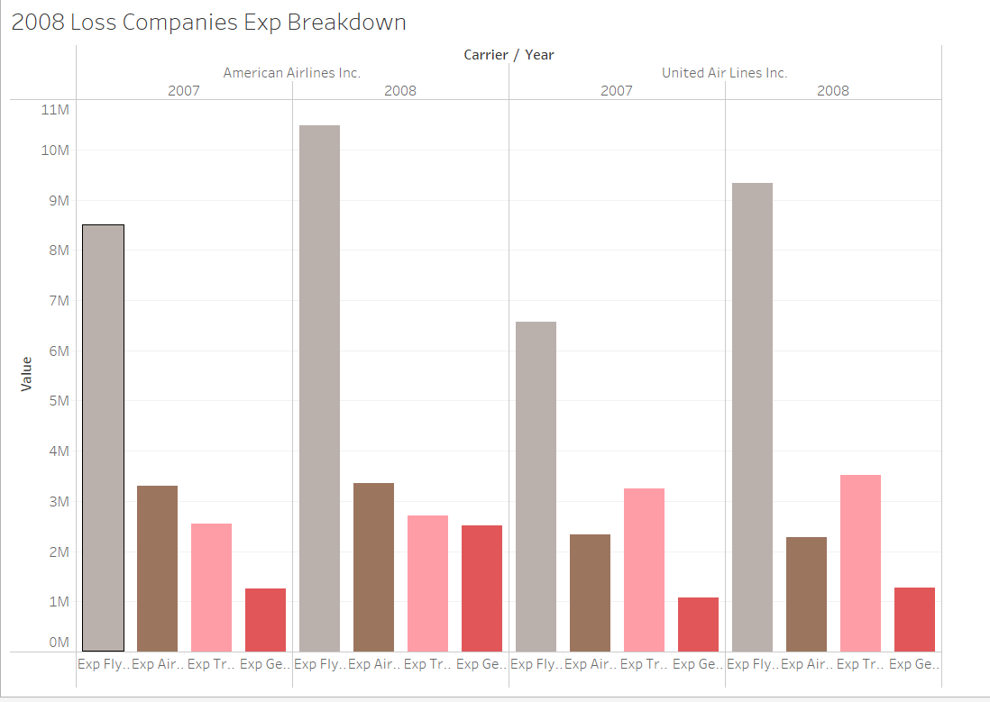
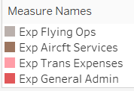
Dip in Profitability in 2008
American Airlines and United Airlines faced losses in 2008, bringing overall industry profitability low for the year of 2008 to -1.4% of Total Revenue even though Total Revenue was almost constant YoY
The 2 Airlines had similar revenues to 2007 but increased Total Expenses
Major increases in expenses were in flying ops for both companies, and General Admin Expenses for American Airlines in particular

Slide 15
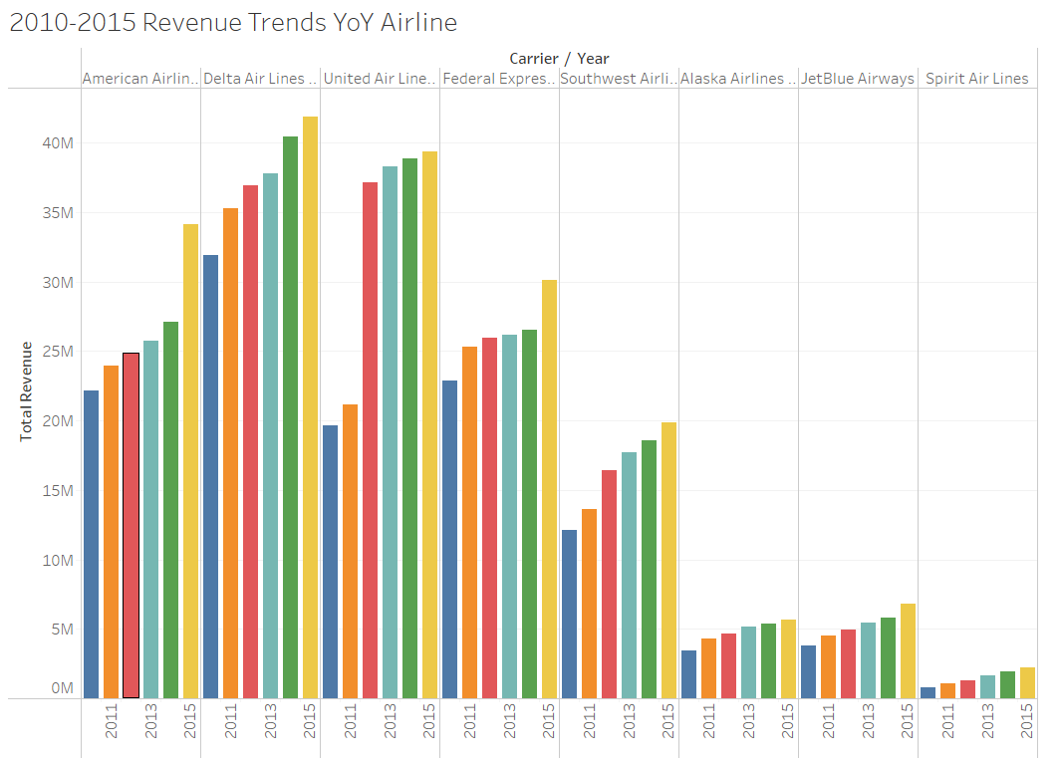
2010-2015 Profitability Attribution
Between 2010 and 2015, the increasing revenues and profitability can be attributed towards most airlines brining in increasing revenues
The total revenues are increasing because of higher trans_rev_pax indicating either a price decrease across the industry or more consumer demand due to less security fears or increasing GDP of the economy
2015 Q3 was the most profitable quarter of the industry, with $10.7 M profit

Slide 16
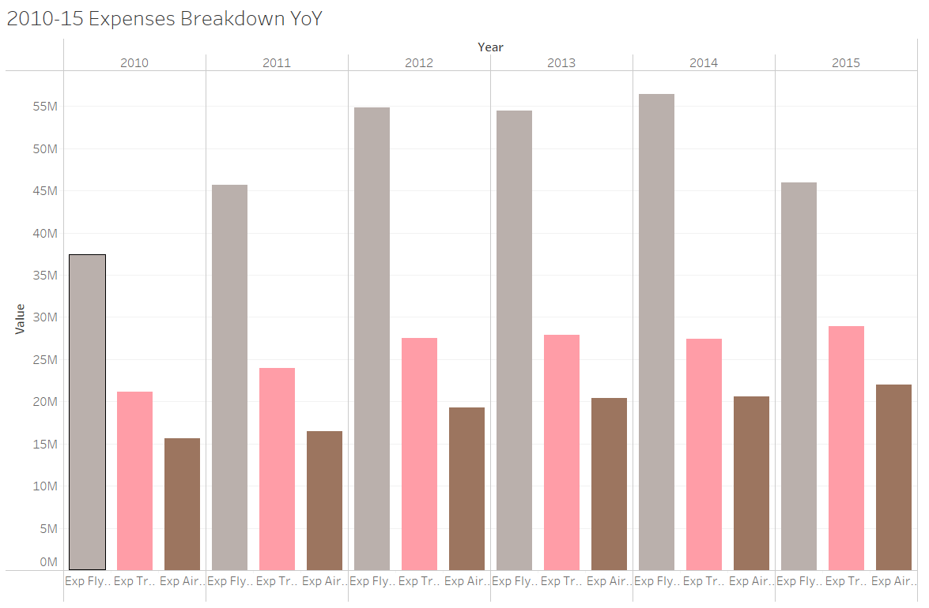
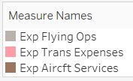
Exp Breakdown 2010-2015
Flying costs not increasing as much even though more revenue is being generated, indicating favorable oil prices or lower industry wages in these years
Marginal increase in expenses not as high as the marginal increase in revenue in those years

Slide 17
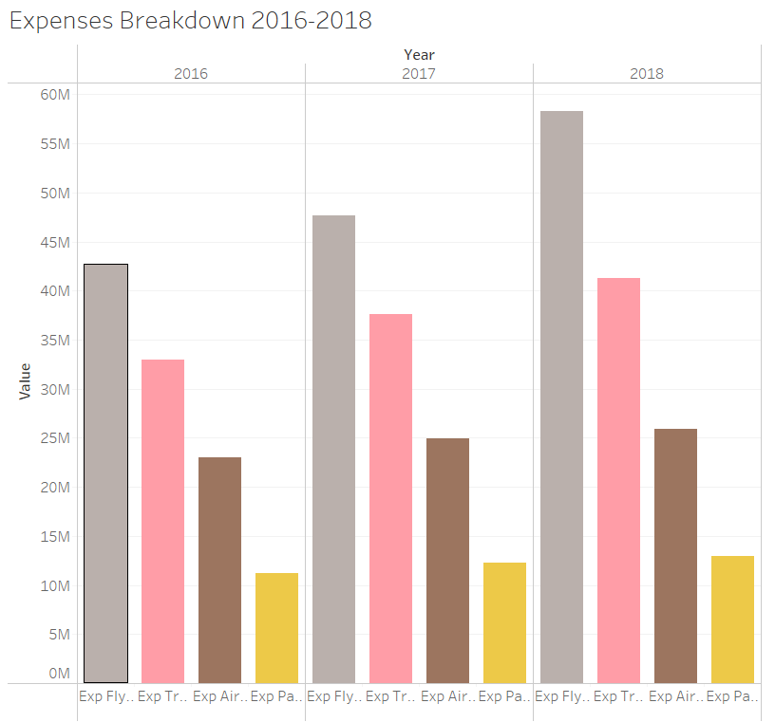
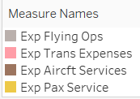
2016-2018 Rising Expenses
Revenue increasing from 2015-2018 but with lower profitability %age due to increasing Total Expenses
Rising fuel costs could explain why flying costs have increased for all airlines in those years
Marginal expense greater than revenue

Slide 18
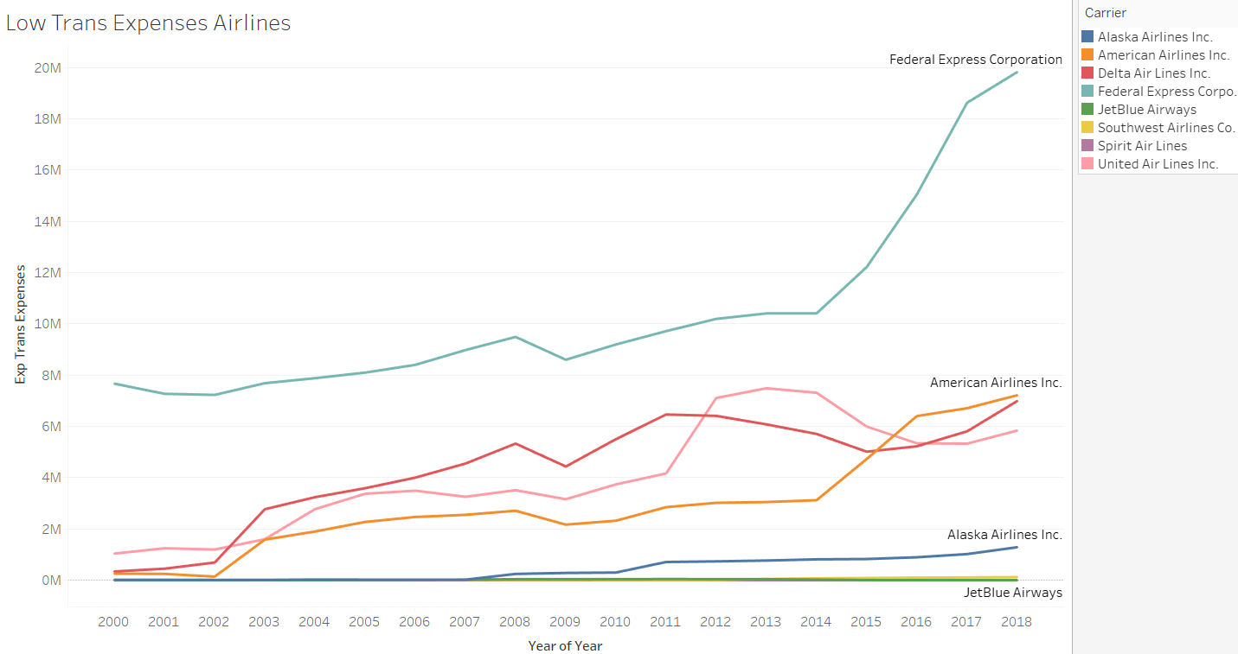
Low-Cost Airlines Business Model
Low-Cost Airlines such as Spirit and Southwest are able to maintain profitability due to lower expenses such as trans_rev_expenses

Slide 19
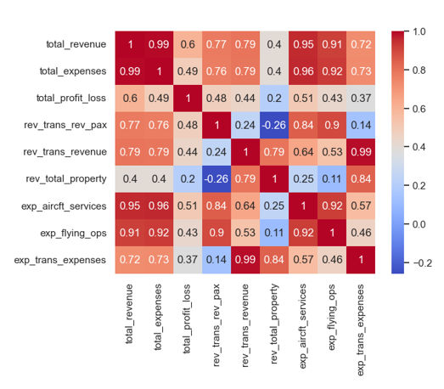
Correlation of Revenue/Expenses & Profit
Higher correlation of Rev (0.6) with Profit than Exp (0.49) with Profit

Slide 20
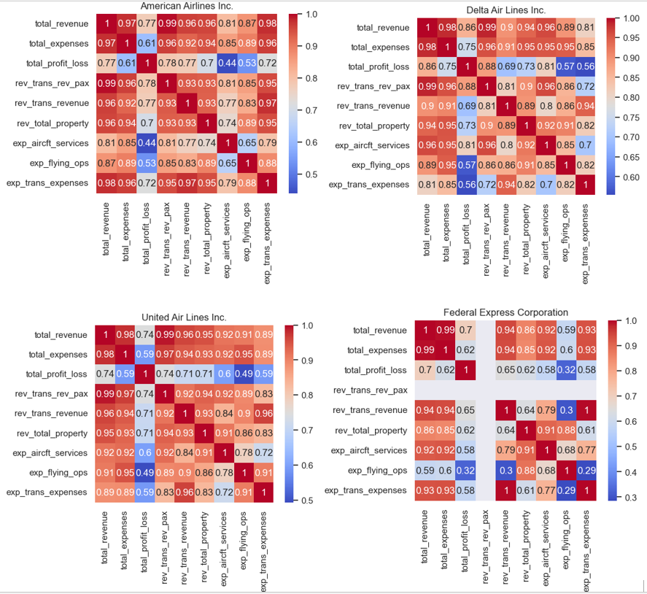
Correlation by Airline

Slide 21
Correlation by Airline Points
Fed Ex Flying ops and total revenue not as highly correlated as other 3 airlines
Exp Aircraft services highly correlated (0.8) with P/L for Delta as opposed to other 2 (0.5)
Rev_trans_revenue not as highly correlated with other variable for Spirit than the other 2 low-cost airlines

Slide 22
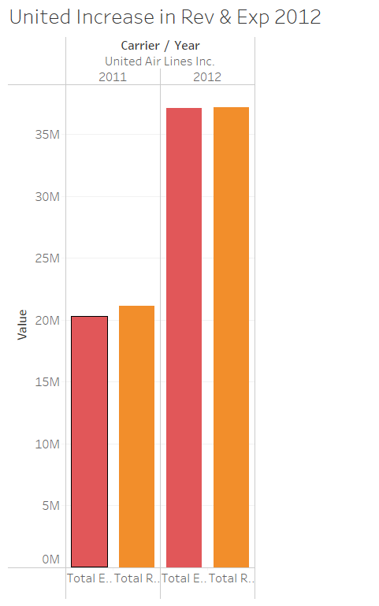
United Airlines Outlier Case
United Airlines made a significant jump in Total Revenue from 2011 to 2012 from 21 M to 37 Mil, as well as a jump in Total Expenses from 20M to 37M
This could mean an increase in demand for this airline and an increase in services with more frequent flights or more destinations

Slide 23
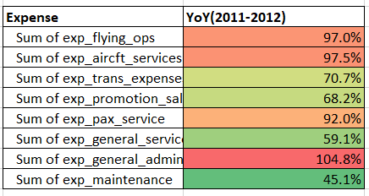
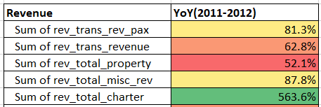
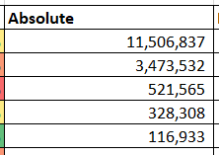
United Deep Dive 2012
Revenue Total Charter increased by 564% but the absolute amount wasn’t enough to explain why the Total Revenue for United increased in 2012
With excess aircrafts, it seems that United Airlines was able to schedule more charter flights than usual

